Slide 1
BCSE102L- Structured and Object-Oriented Programming
Dr. R. Arumuga Arun
PRP 315(AB) – 19
arumugaarun.r@vit.ac.in

Slide 2
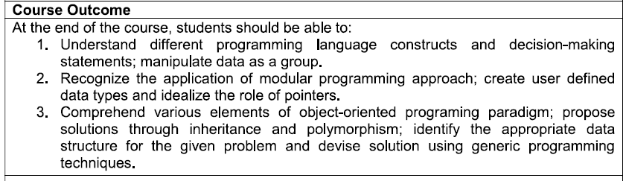
Course Outcomes

Slide 3
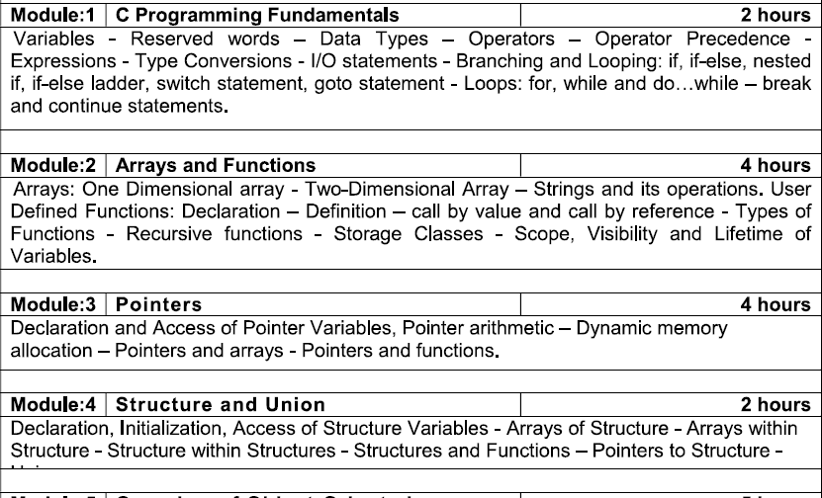
Syllabus

Slide 4
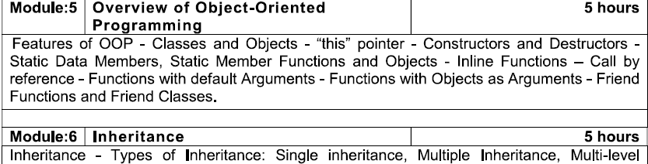
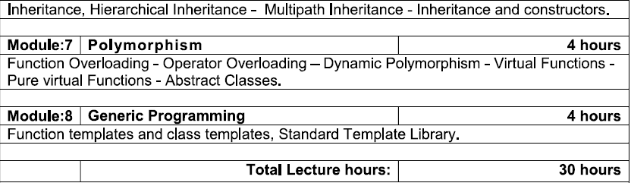
Syllabus

Slide 5
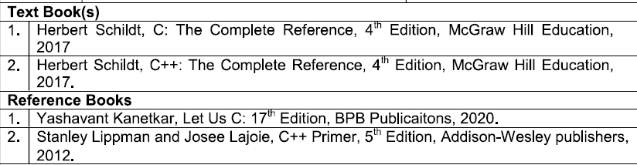
Text Books & References

Slide 6
Internal Components
Quiz 1 – 10 Marks
Will be conducted during the CAT 1 period
Quiz 2 – 10 Marks
Will be conducted during the CAT 2 period
DA – 10 Marks
CAT 1 – 15 Marks
CAT 2 – 15 Marks

Slide 7

A computer is defined as follows :
A computer is a programmable machine that receives input, stores and manipulates data, and provides output in a useful format.
In regard to today’s computers, the “machine” part of the computer is called the hardware, while the “programmable” part is called the software

Slide 8
Computer Science
Computers are used just about everywhere in our society:
• Communications: internet, e-mail, cell phones
• Word Processing: typing/printing documents
• Business Applications: accounting, spreadsheets
• Entertainment: games, multimedia applications
• Database Management: police records, stock market
• Engineering Applications: scientific analysis, simulations
• Manufacturing: CAD/CAM, robotics, assembly
• ... many more ...

Slide 9
Program
A program is a sequence of instructions that can be executed by a computer to solve some problem or perform a specified task.

Slide 10
Programs
Computer programs, known as software, are instructions to the computer, telling it what to do.
Computers do not understand human languages, so you need to use computer languages in computer programs.
Programming is the creation of a program that is executable by a computer and performs the required tasks.

Slide 11
Problem Solving
Problem-solving is the art of identifying problems and implementing the best possible solutions
Regardless of the area of study, computer science is all about solving problems with computers.
The problems that we want to solve can come from any real world.
We need to have a standard systematic approach to solving problems.
Problem Solving is the sequential process of analyzing information related to a given situation and generating appropriate response options

Slide 12
Machine Language
A computer’s native language is a machine language—a set of built-in primitive instructions.
These instructions are in the form of binary code, so in telling the machine what to do, you have to enter binary code.
Programming in machine language is a tedious process.
Moreover, the programs are highly difficult to read and modify.
For example, to add two numbers, you might have to write an instruction in binary like this:
1101101010011010

Slide 13
Assembly language
Assembly language is a low-level programming language in which a mnemonic is used to represent each of the machine-language instructions.
For example, to add two numbers, you might write an instruction in assembly code like this:
ADDF R1, R2, R3

Slide 14
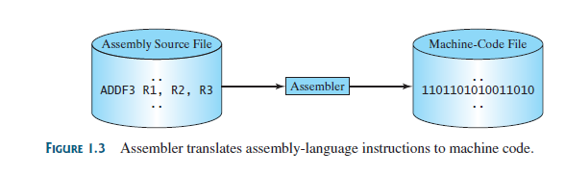
Assembler
However, since the computer cannot understand assembly language, a program called an assembler is used to convert assembly-language programs into machine code,

Slide 15
High-level language
The high-level languages are English-like and easy to learn and program.
Here, for example, is a high-level language statement that computes the area of a circle with radius 5:
area = 5 * 5 * 3.1415;

Slide 16
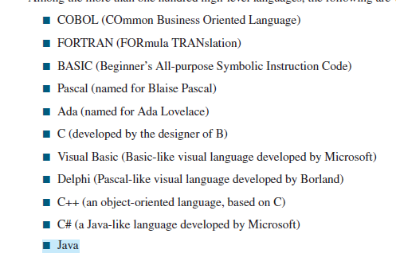
Well known high-level languages

Slide 17
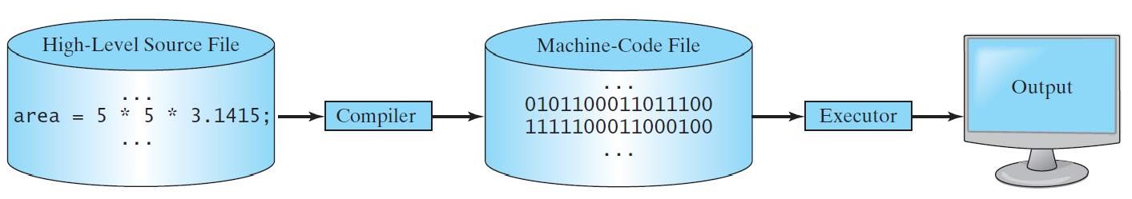
Compiling Source Code
A compiler translates the entire source code into a machine-code file, and the machine-code file is then executed, as shown in the following figure.

Slide 18
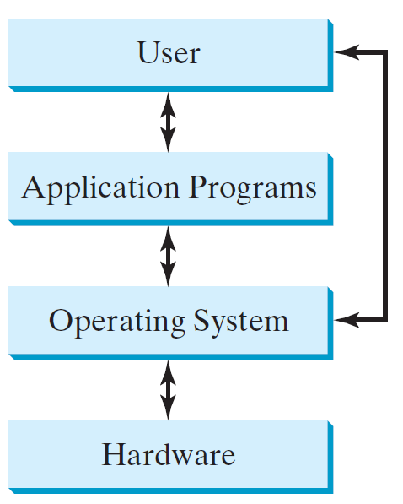
Operating Systems
The operating system (OS) is a program that manages and controls a computer’s activities.
The popular operating systems for general-purpose computers are Microsoft Windows, Mac OS, and Linux.
Application programs, such as a Web browser or a word processor, cannot run unless an operating system is installed and running on the computer.

Slide 19
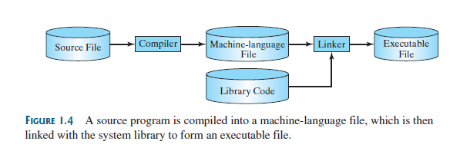
A program written in a high-level language is called a source program or source code.
Since a computer cannot understand a source program, a program called a compiler is used to translate it into a machine-language program.
The machine-language program is then linked with other supporting library code to form an executable file, which can be run on the machine

Slide 20
C and C++
C programming language was developed in 1972 by Dennis Ritchie at Bell laboratories of AT&T (American Telephone & Telegraph), located in the U.S.A.
Dennis Ritchie is known as the founder of the c language.
It was developed to overcome the problems of previous languages such as B, BCPL, etc.
C++ was invented by Bjarne Stroustrup in 1979, while he was working at Bell Laboratories in Murray Hill, New Jersey.
Stroustrup initially called the new language “C with Classes.”

Slide 21
C and C++
However, in 1983, the name was changed to C++.
C++ extends C by adding object-oriented features. Because C++ is built on the foundation of C, it includes all of C’s features, attributes, and benefits.
This is a crucial reason for the success of C++ as a language. The invention of C++ was not an attempt to create a completely new programming language.
Instead, it was an enhancement to an already highly successful one.

Slide 22
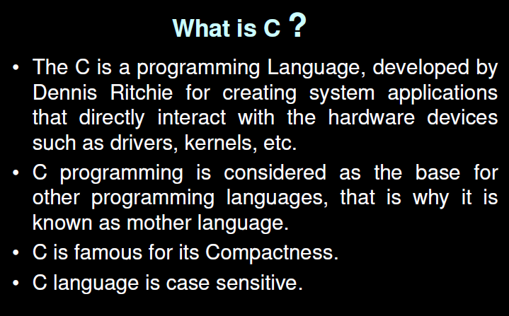

Slide 23
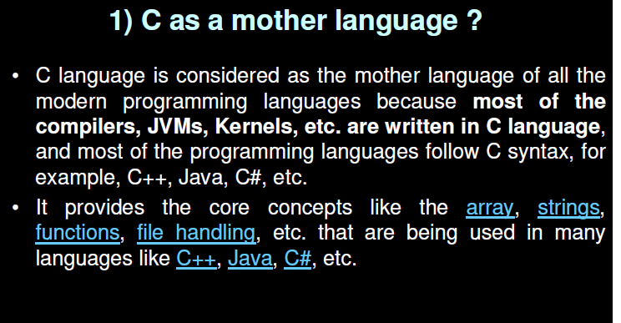

Slide 24
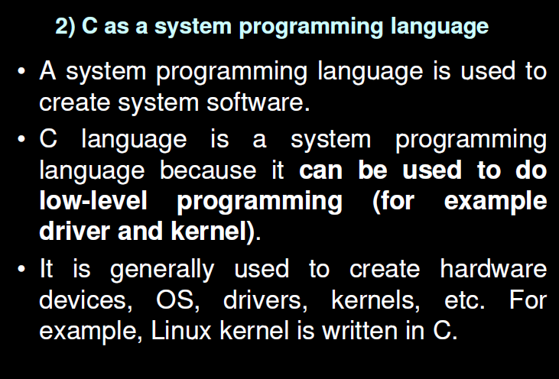

Slide 25
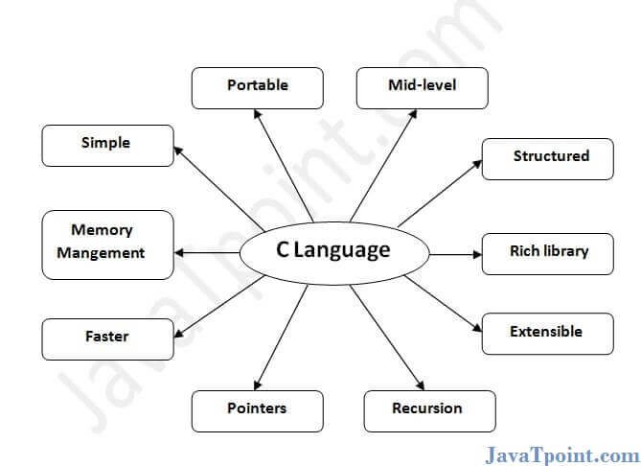
Features of C Language

Slide 26
C is the widely used language. It provides many features that are given below.
Simple
Machine Independent or Portable
Mid-level programming language
structured programming language
Rich Library
Memory Management
Fast Speed
Pointers
Recursion
Extensible

Slide 27
1) Simple
C is a simple language in the sense that it provides a structured approach (to break the problem into parts), the rich set of library functions, data types, etc.
2) Machine Independent or Portable
Unlike assembly language, c programs can be executed on different machines with some machine-specific changes. Therefore, C is a machine-independent language.
3) Mid-level programming language
Although, C is intended to do low-level programming. It is used to develop system applications such as kernel, driver, etc.
It also supports the features of a high-level language. That is why it is known as a mid-level language.

Slide 28
4) Structured programming language
C is a structured programming language in the sense that we can break the program into parts using functions.
So, it is easy to understand and modify. Functions also provide code reusability.
5) Rich Library
C provides a lot of inbuilt functions that make the development fast.
6) Memory Management
It supports the feature of dynamic memory allocation. In C language, we can free the allocated memory at any time by calling the free() function.
7) Speed
The compilation and execution time of C language is fast

Slide 29
8) Pointer
C provides the feature of pointers. We can directly interact with the memory by using the pointers. We can use pointers for memory, structures, functions, array, etc.
9) Recursion
In C, we can call the function within the function. It provides code reusability for every function. Recursion enables us to use the approach of backtracking.
10) Extensible
C language is extensible because it can easily adopt new features.

Slide 30
First C Program
#include <stdio.h>
int main()
{
printf("Hello C Language");
return 0;
}

